Slide 1
The Bowels of the Earth

Slide 5
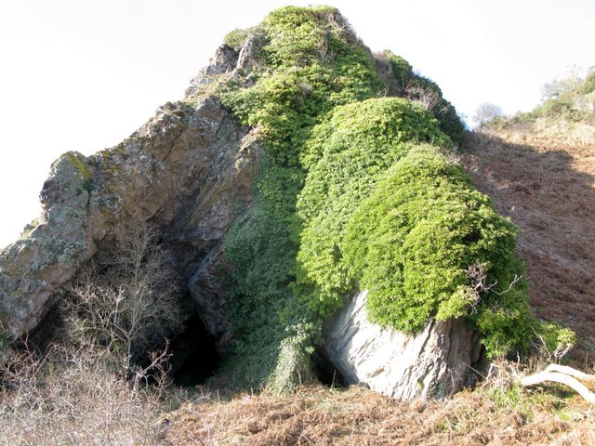

Slide 15
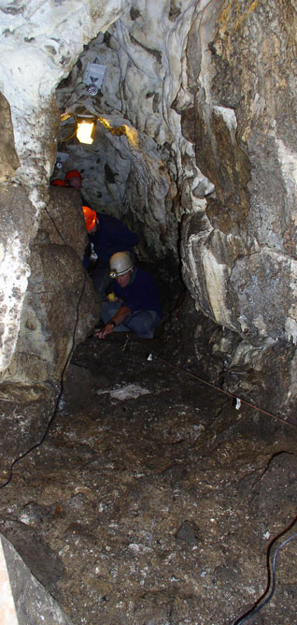

Slide 16
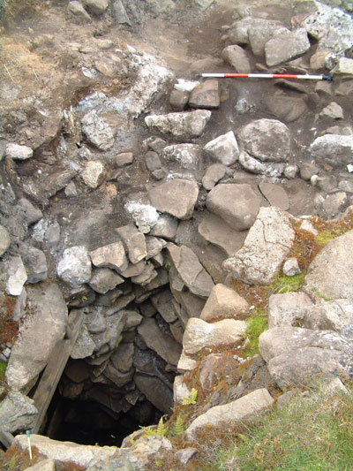

Slide 18
…and in England, Church Hole, Creswell

Slide 21
The “Red Lady of Paviland”
at Goat’s Hole on the Gower Peninsular.

Slide 22
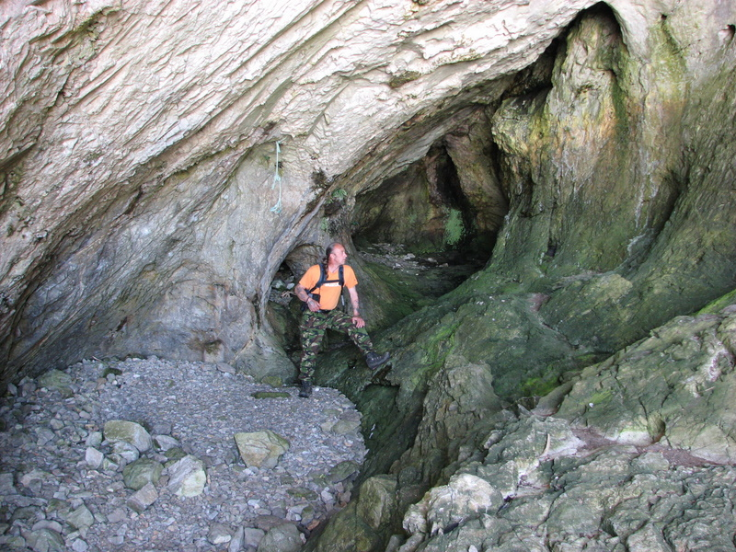

Slide 24
Goat’s Hole, Paviland, Gower Peninsular

Slide 26
Grotte de Niaux, Pyrenees, France

Slide 30
Sculptors Cave, Covesea, Lossiemouth

Slide 33
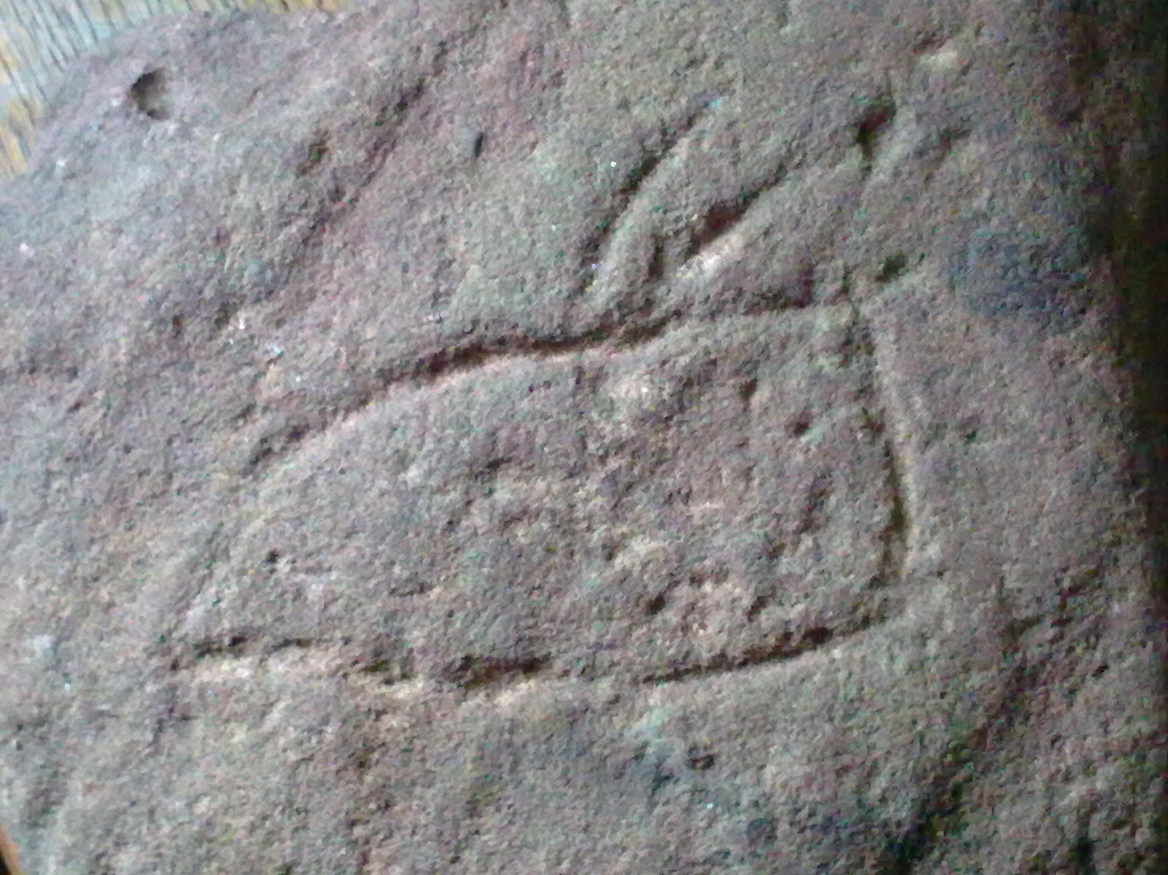
The Bowels of the Earth …
… Food for Thought?

